Slide 1
Machine Learning-Based Early Prediction of Fish Diseases Through Water Quality Analysis
Under the Guidance of
Dr.Bhanu Pratap Reddy B
Associate Professor
Presenting by batch 27:
23761A12B3 - P. Varalakshmi
23761A12B0 - P. Krishna Vamsi
23761A1296 - K. Narasimha Rao

Slide 2
Outline
Abstract
Existing System
  Disadvantages
Proposed System
  Advantages
Literature Survey
System Design
Implementation
References

Slide 3
ABSTRACT
Aquaculture plays a significant role in food production and the economy, but fish diseases continue to be a major challenge for fish farmers. One of the primary causes of these diseases is poor water quality, which directly affects the health and growth of fish. This project presents a machine learning-based approach for the early detection of fish health risks using important water quality parameters such as pH, dissolved oxygen (DO), temperature, turbidity, conductivity, nitrate, biological oxygen demand (BOD), and bacterial indicators. The proposed solution offers an efficient, cost-effective, and intelligent decision support system for aquaculture management. By enabling early detection of potential health risks, it helps improve fish survival, reduce disease outbreaks, enhance water quality management, and support sustainable fish farming practices.

Slide 4
EXISTING SYSTEM
Disadvantages
Uses only one or two machine learning algorithm.
Focuses only on disease prediction and does not provide the reason behind the prediction.
Does not offer recommendations or preventive measures to improve water quality.
No dashboard for visualizing predictions and water quality analysis.

Slide 5
PROPOSED SYSTEM
Advantages:
Trains and compares multiple machine learning algorithms and select the best-performing model for higher prediction accuracy.
Classifies different types of fish diseases instead of only predicting whether the fish is healthy or diseased.
Identifies the water quality parameters which are responsible for the predicted disease.
Provides recommendations to improve water quality and reduce the risk of disease.
Features an interactive dashboard to display prediction results, performance metrics, and water quality analysis.

Slide 6
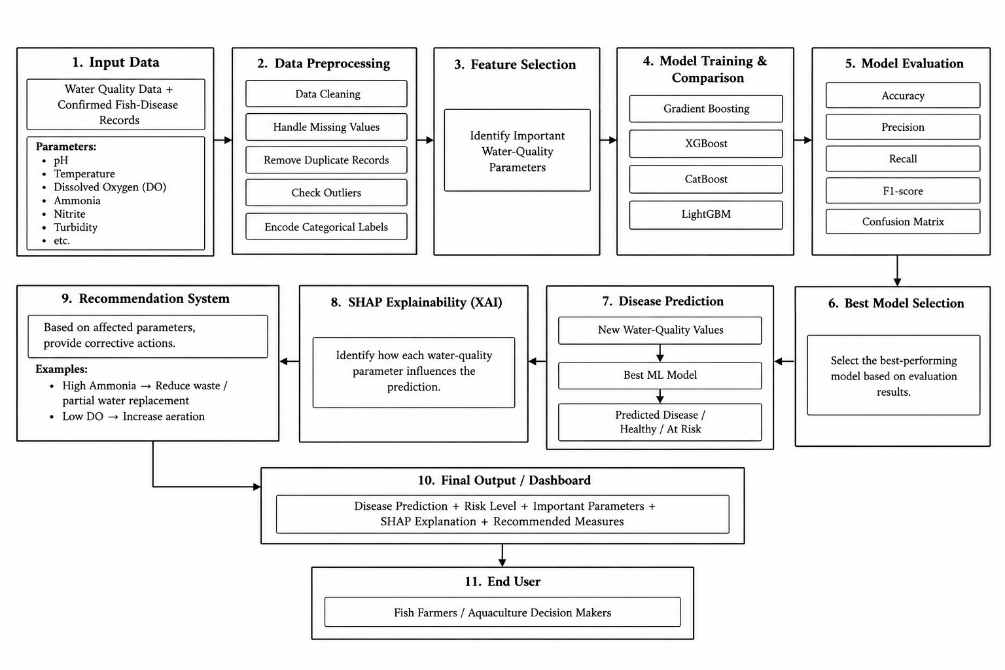
System Design

Slide 7
Implementation
Data Collection - Collect water-quality data and confirmed fish-disease records such as pH, temperature, DO, ammonia, nitrite and turbidity.
Data Preprocessing - Clean the dataset by handling missing values, removing duplicates, checking outliers, and encoding labels.
Feature Selection & Model Training - Select important water-quality parameters and train Gradient Boosting, Support Vector Machine.
Model Evaluation & Prediction - Comparing the models using Accuracy, Precision, Recall, F1-score and Confusion Matrix, then select the best-performing model for prediction.

Slide 8
LITERATURE SURVEY
Paper Title | Year | Author | Methods/Models Used | Key Contribution | Accuracy
Predictive Modelling of Fish Diseases Using Machine Learning on Water Quality Parameters [1] | 2025 | N Srujana Roy | Random Forest Classifier | predicts fish disease conditions using water quality parameters. | 89%
AI-powered decision support system for mariculture: Real-time fish mortality prediction with random forest | 2026 | RamadhonaSaville, Atsushi Fujiwara | Random Forest | Predicts level of fish mortality | 78.6%
Water Quality Prediction Using Machine Learning Models | 2024 | Astha Sharma | Decision Tree | Compared multiple Machine Learning models for water quality prediction. | 58.84%

Slide 9
LITERATURE SURVEY
Paper Title | Year | Author | Methods/Models Used | Key Contribution | Accuracy
Predicting Fish Diseases Using ML Based on Water Quality Parameters [2] | 2024 | Rajkumar R | Logistic Regression, SVM | Requires manual monitoring of water quality parameters. | 82%
Fish Disease Prediction Using Machine Learning on Water Quality Data | 2026 | Rajat Kumar | Random forest Classifier | Used Random Forest Classifier for detect easily | 89.25%
Predicting Aquaculture Water Quality Using Machine Learning Approaches[3] | 2024 | Tingting Li et al. | SVM, LSSVM | Improved water quality prediction using SVM. | 89%

Slide 10
REFERENCES
Rajkumar R., Vishnu Sai Nallagatla, Rahul S. G., Lokesh Akula, Saketh Reddy Balpunuri, and Nandhini, "Predicting Fish Diseases Using Machine Learning Based on Water Quality Parameters," 2024 15th International Conference on Computing, Communication and Networking Technologies (ICCCNT), IEEE, 2024, doi: 10.1109/ICCCNT61001.2024.10725573.
Dr. T. Sravan Kumar, K. Nandulal, and M. Varalaxmi, "Machine Learning-Based Early Detection of Fish Diseases Through Water Quality Monitoring," Journal of Nonlinear Analysis and Optimization (JNAO), 2023.
Md. Shoaib Ahmed, T. T. Aurpa, and Md. A. K. Azad, "Fish Disease Detection Using Image Based Machine Learning Technique in Aquaculture," Journal of King Saud University – Computer and Information Sciences, vol. 34, no. 8, pp. 5170–5182, 2022. DOI: 10.1016/j.jksuci.2021.05.003.
Saville, R., Fujiwara, A., Hatanaka, K., Wada, M., Yaman, A., Puspasari, R., Albasri, H., & Dwiyoga, N. (2026). AI-powered decision support system for mariculture: Real-time fish mortality prediction with random forest. Aquacultural Engineering, 112, 102621.

Slide 11
THANK YOU

